Slide 1
Duchesne County School District Jason Young, Assessment Director Tom Felkins, Technology Trainer James Sasser, Technology Trainer September 2015
2015 Interim SAGE Assessment Training

Slide 2
This presentation and the TAM will be posted to dcsdtraining.weebly.com under the “more” tab, SAGE training.
Special thanks to Jordan School District.
My email is tfelkins@dcsd.org
My phone # is 725-4602.

Slide 3
SAGE Testing Ethics and Test Security
Sage Assessments are highly secure. Make sure that all teachers who administer SAGE assessments always remember to:
Verify students’ identity before approving their participation in SAGE tests.
Do Not allow students to remove any SAGE test content.
DO Not take any SAGE test content back to their classroom to work on it.
Securely destroy any and all SAGE notes and student work after students are finished with the test.
Know and follow the SAGE Test Administration Manual (TAM) directions exactly as given.

Slide 4
Make sure that…
All teachers, and other staff members, who assist with Summative SAGE assessments in any way, have completed testing ethics training.
Teachers and other staff members are provided with a copy of USOE’s “Testing Ethics Policy” document and informed of their responsibility to understand and follow the document’s contents.
Signed documentation is maintained verifying teachers’, and other staff members’, understanding of ethical testing procedures and agreement to follow ethical testing practices. (Ethics Policy Sign-off form)
The new SAGE browser must be installed on every machine that will be used for testing

Slide 5
SAGE Testing Windows
SAGE Interim Test
Grades 3-12: 11/2/15 – 11/24/15
SAGE Summative Test
SAGE Writing: 4/4/15 – 5/19/15
SAGE ELA: 4/4/15 – 5/19/15
SAGE Math: 4/4/15 – 5/19/15
SAGE Science: 4/4/15 – 5/19/15

Slide 6
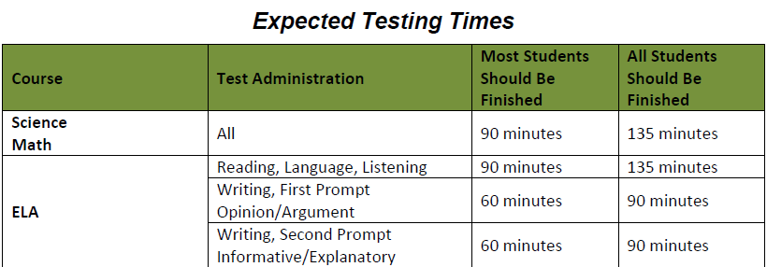
2015 SAGE Testing Times
“Though these assessments are untimed, it is inappropriate for the test administrator to allow students to take excessive time to test.
In rare circumstances a student may need to take longer than the expected times. These situations must be discussed with the LEA Assessment Director to ensure that students have an appropriate opportunity to complete testing.”
-SAGE Interim, Mid-Year Summative, and Spring Summative
Test Administration Manuals

Slide 7
Test Delivery System (TDS)
Test Administrator (TA) Interface
Go to http://sageportal.org
Click on Teachers:

Slide 8
Accounts have been created for all teachers.
If a user is not able to access SAGE, click Forgot Your Password? on the login page.
If individuals still are not able to login to SAGE, please have them contact the SAGE Help Desk at sagehelpdesk@air.org
Or myself at tfelkins@dcsd.org 725-4602

Slide 9
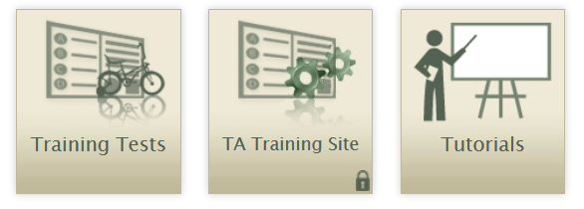
There are several menus you will use as you access the sage portal.
Click on either [SAGE Live Test Administration] or [Training Sites]
Clicking on the Training sites will bring up these (3) options.

Slide 10
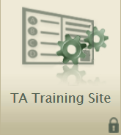
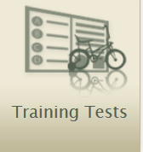
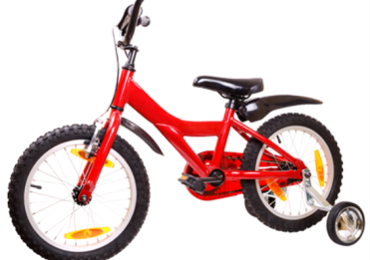
TDS “Training Sites”
Test Administrator (TA) Training Site
Teachers practice administering training tests
Can be used with students who are logged in to a training test session.
Student Training Site (Training Tests) (will be discussed in the next section)
Students practice taking tests online and become familiar with the item types, test tools and features
Can also log in to a training test session created by a TA
Can be accessed with either the secure browser or a supported web browser.
The student training site has a distinct look that sets it apart from the live site.
A red bar runs along the top of the test page
There is a big red bike with training wheels on the “Sign In” screen.

Slide 11
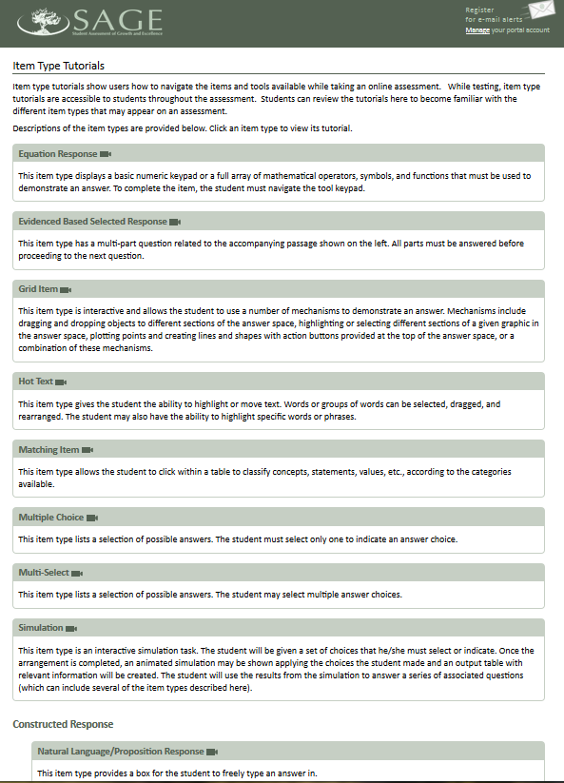
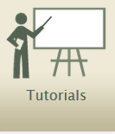
The “Tutorials” button will bring up links to video clips showing students the design, format, and procedures for responding to 13 different types of items on SAGE tests:
Equation Response
Evidence Based Selected Response
Grid Items
Hot Text
Matching Items
Multiple Choice
Multi-Select
Simulation
Constructive Response
Natural Language/Proposition Response
Short Answer/Extended Response
Word Builder/Constructed Response
Editing Tasks
Editing Task with Choice
Editing Task

Slide 13
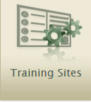
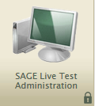
Logging into either the “Training Sites” OR the “SAGE Live Test Administration”
If administering a “Training” SAGE test, make sure it says “SAGE Training Tests” here.
If administering a “Live” SAGE test, make sure it says “SAGE Live Tests” here.

Slide 14
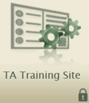
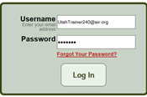
Beginning to Administer a Training Test
1.
Select the “TA Training Site” Icon
2.
Login to SAGE portal
Select tests to be included in the session.
Click boxes for all tests students will be taking during that session,

Slide 15
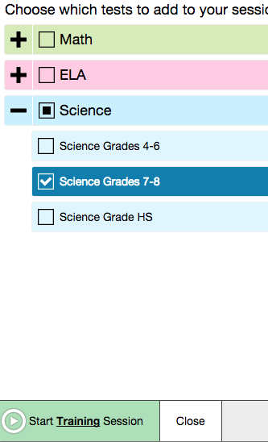
Press the green “Start Testing Session” button to start a session. You must do this before students can log in to the SAGE test.
The session ID will appear here. Students will need this information to access the testing session.
As students login to get approval to begin the test, their names, and the tests they are to take, appear in this box.

Slide 16
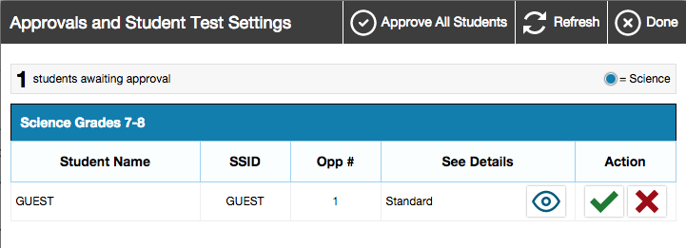
To approve students to begin a test, first click on the Approvals button.
Approve all students listed by clicking this button, or approve students individually by clicking this button.
Make sure that you recognize the students needing to be approved AND that they are taking the correct SAGE test.

Slide 17
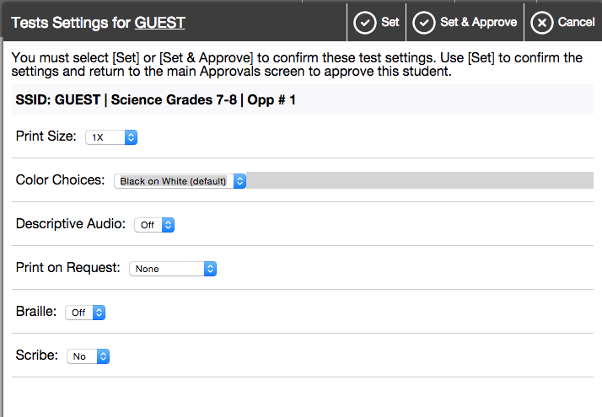
To see or edit “Test Settings” before approving a student to begin his/her test, click here.
After confirming or editing “Test Settings”, click “Set” to save any changes and return to the previous screen
Click “Set & Approve” to save any changes and approve the student to take the specified test.
Click “Cancel” to return to the previous screen without making or saving changes.

Slide 18
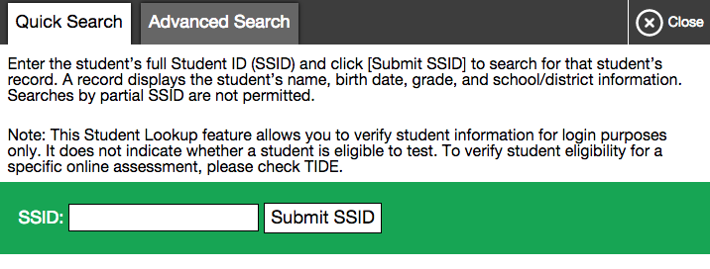
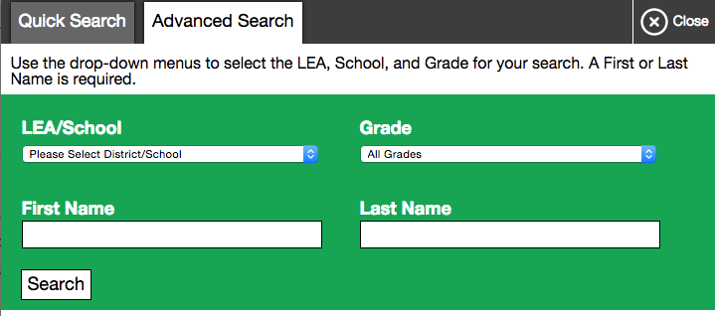
To look up student demographic information, click on this button.
To look up a student’s name, birthdate, grade, and school, and you know the SSID, use the “Quick Search”.
To look up a student’s SSID, use the “Advanced Search”.

Slide 19
The “Students in Your Test Session” table displays each logged in and approved student.
Each student’s test status, and progress through a SAGE test, can be monitored here.
One or more student test(s) can be paused by clicking here.

Slide 20
Monitoring Student Progress: Student Statuses

Slide 21
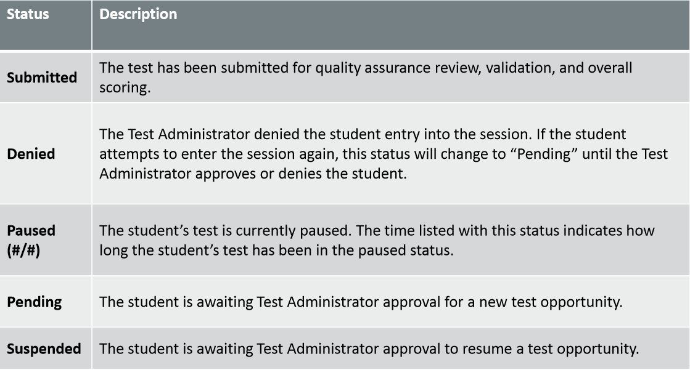
Monitoring Student Progress: Student Statuses (cont.)

Slide 22
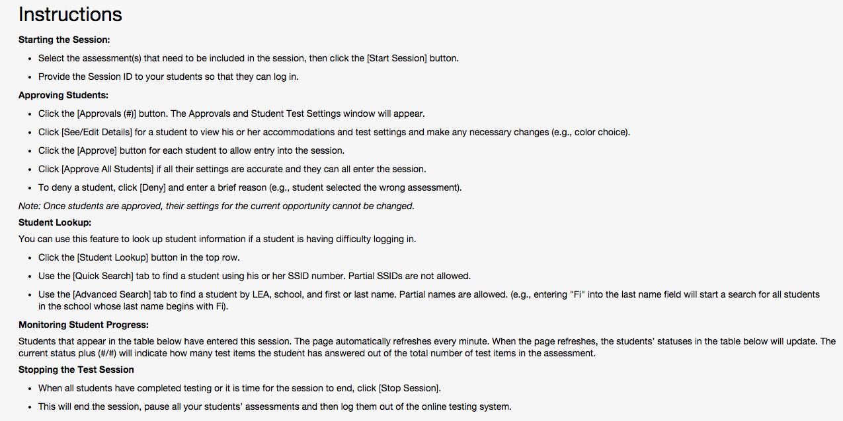
Instructions for starting a session, approving students, student lookup, and monitoring student progress are all available during a testing session by reading the instructions shown here:

Slide 23
Stopping / Pausing Tests
Through the TA Interface, Test Administrators may:
or
Pause (logout) individual students.
Stop an entire session for all students.
This box will then appear, requesting verification to end the session and log students out Click ok or cancel to keep the session open.

Slide 24
Test Delivery System (TDS)
Student Interface

Slide 25
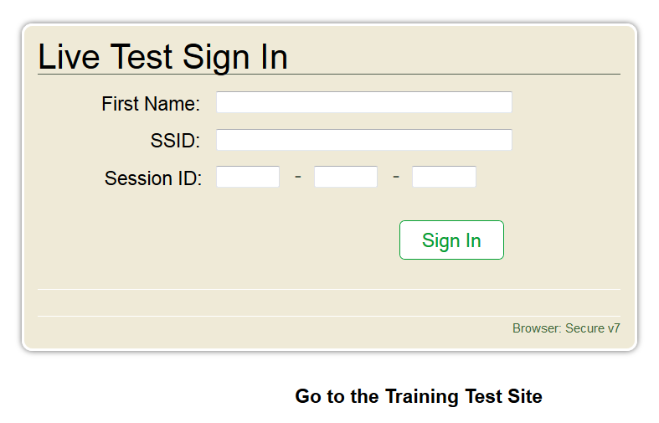
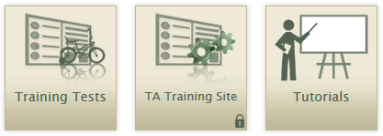
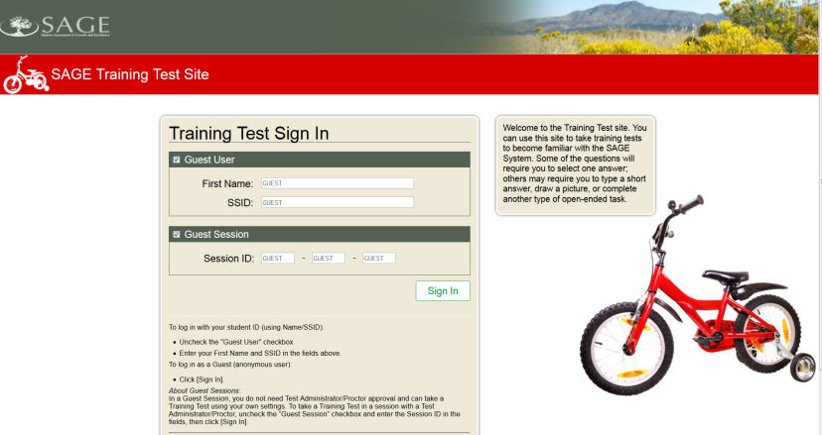
Students’ Access to Sage Assessments
Student Access to SAGE LIVE Tests
Student Access to SAGE TRAINING Tests
Sageportal.org
Secure browser access to training test
Secure Browser Access To SAGE LIVE Tests

Slide 26
Logging into a SAGE Training Test Session as a Student
To simply log in to SAGE training tests as a “Guest”, or to take any training test, leave the these two checkmarks in place.
Click the “Sign In” button to proceed.
To log in to a SAGE training test as a specific person, and/or to participate in a created SAGE Training Session, deselect one or both Guest session box, and enter the requested information.
If logging into a specific SAGE training session, enter the Session ID information.

Slide 27
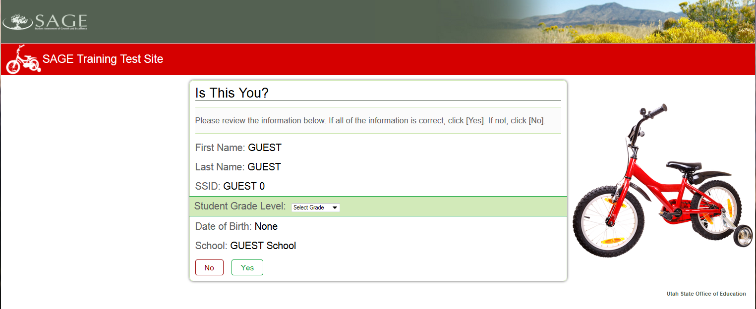
After logging in, the student will be asked to verify her/his identity.
If taking a training test, a grade will need to be selected.
If the information is correct, click “YES”

Slide 28
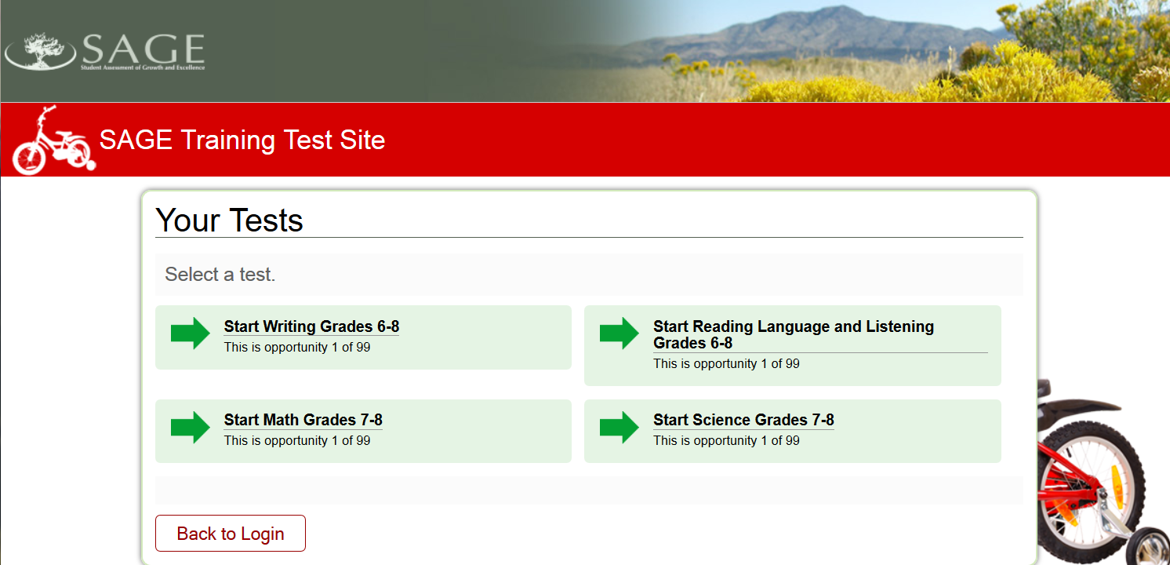
The SAGE test to be taken is then selected.
The only SAGE tests that will be displayed will be those selected when the test session was created.

Slide 29
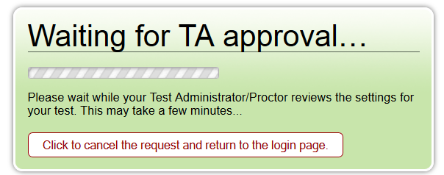
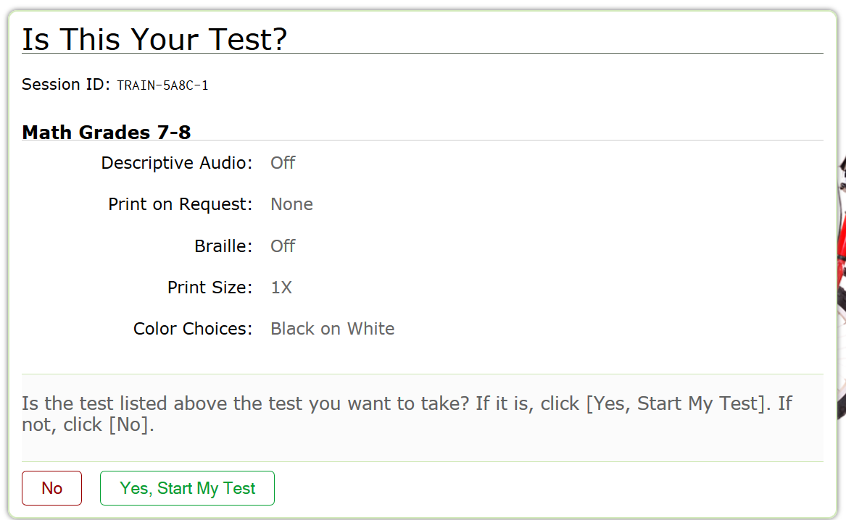
Once the student has selected a SAGE Test, he/she will see this message.
When the teacher (test administrator-TA) approves the student’s entry into the selected test, the student will be asked to verify the test she/he is taking.
If the selected test is correct, the student clicks “Yes, Start My Test” to begin.

Slide 30
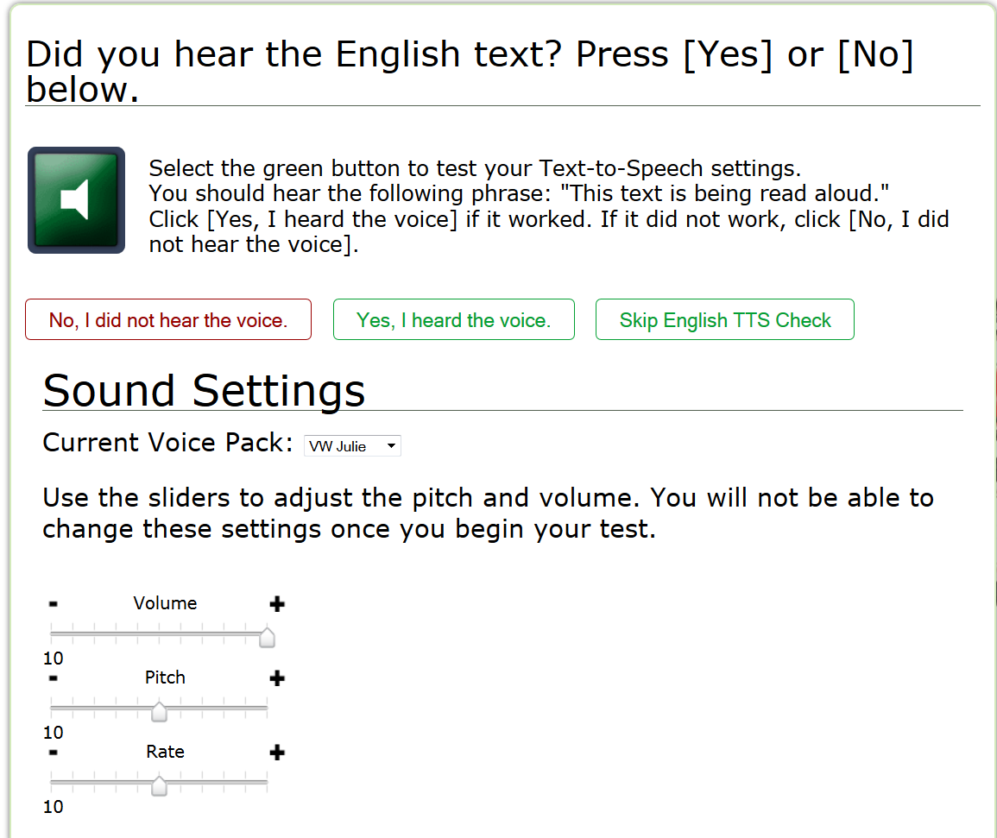
When taking either a “LIVE SAGE Test” or a “Training Test” using the secure browser, the student will be asked to conduct a sound check for the “Text-to-Speech” (TTS) feature.
The TTS sound test is conducted by clicking the green speaker box .
If the words, “This text is being read aloud.” are heard, the TTS sound test was successful and this box should be clicked.
If the secure browser is NOT used to take a training test, the “Text-to-Speech (TTS) sound check will not be available.
If needed, the student may change the volume, pitch, or rate of the sound for the TTS feature.
For 2015, the volume can also be adjusted during the test. This will be explained in a future slide.

Slide 31
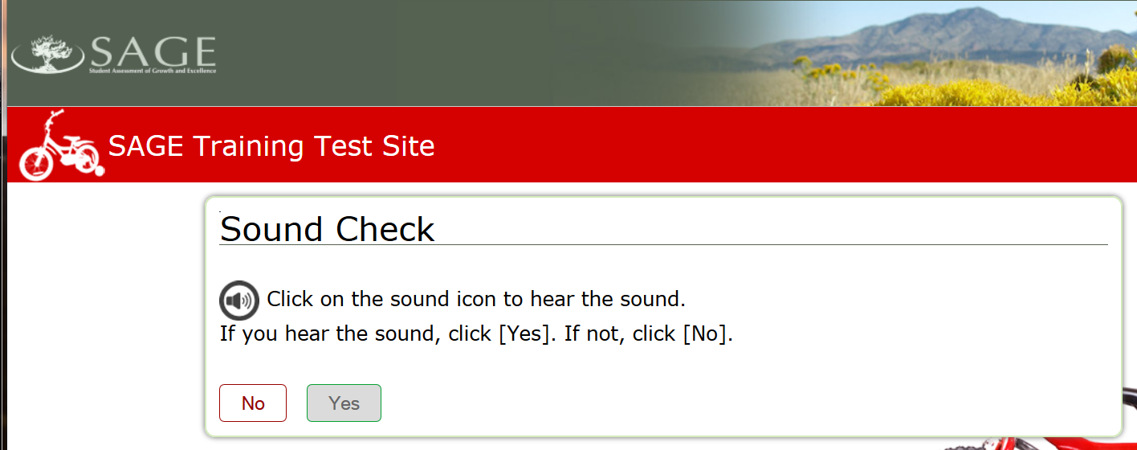
If a student is taking a Reading, Language, and Listening “LIVE” or “Training” test, a listening “Sound Check” will also be conducted.
To conduct the listening “Sound Check”, click on the speaker.
A musical tone will be heard if the system is functioning properly.
If the tone is heard, click yes.

Slide 32
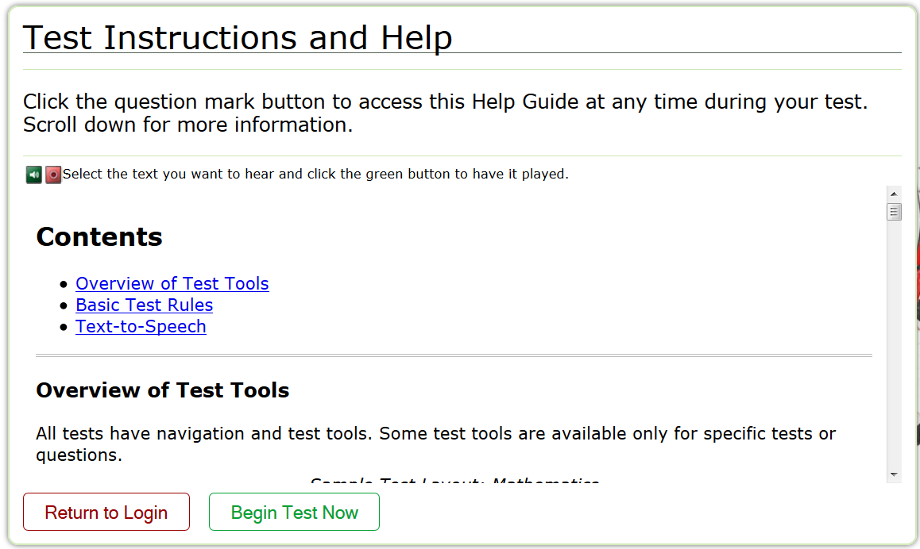
Before seeing test questions, students are given an opportunity to review three important areas of testing instructions and help:
Test Tools
Basic Test Rules
Text-to-Speech feature
To begin the test, students click the “Begin Test Now” button.

Slide 33
Basic Test Rules
Students must answer each question. They can answer a question and mark it for review, then go back to it later to see or change their answer.
Students must answer all questions on a page before moving on to the next page. (Some pages have a lot of information. Students may need to use the vertical scroll bar to view all the information on a page.)
Students can pause their test at any time. Pausing the test will log the student out.
When a student resumes the test, he/she will see the first page that has unanswered questions.
If a student’s test is idle for 20 minutes, the system will automatically pause the test and log the student out.
An exception to this rule is the Writing test. Students may return to a Writing test prompt even after a 20 minute pause has occurred.
For Math (except Math 6th), Science, and ELA Reading and Listening:
If a test is paused for less than 20 minutes and the student logs back in, she/he can review questions already answered.
If a student’s test is paused for more than 20 minutes and the student logs back in, he/she cannot review questions already answered. The only exception is if the student pauses on a page that has at least one unanswered question.

Slide 34
Basic Test Rules (cont.)
The Writing Test and the Math 6th Grade are segmented.
In segmented tests, students must complete all questions in the first segment before moving on to the second segment.
For ELA Writing:
Writing is divided into two segments, each with one written response required. The student can pause within a Writing segment at any time.
For the first essay: The student can review and edit his/her response until they move on to the next segment. Once a student moves on to the second segment, he/she cannot go back to his/her first essay. (Students MUST finish their first writing essay BEFORE looking at or beginning the second writing essay.)
For the second essay: The student can review and edit his/her response until he/she is done and ready to submit the writing test.
Once the writing test has been submitted, neither the first or second essay can be reviewed or edited.
For Math 6th Grade:
The first segment of the Math 6th Test is a non-calculator segment. Students can review and edit their responses until they move to the next segment. Once they move on to the second segment, they cannot go back to the first segment.
For the second segment, the use of a calculator is permitted. Students can review and edit their responses until they are done and submit their test.

Slide 35
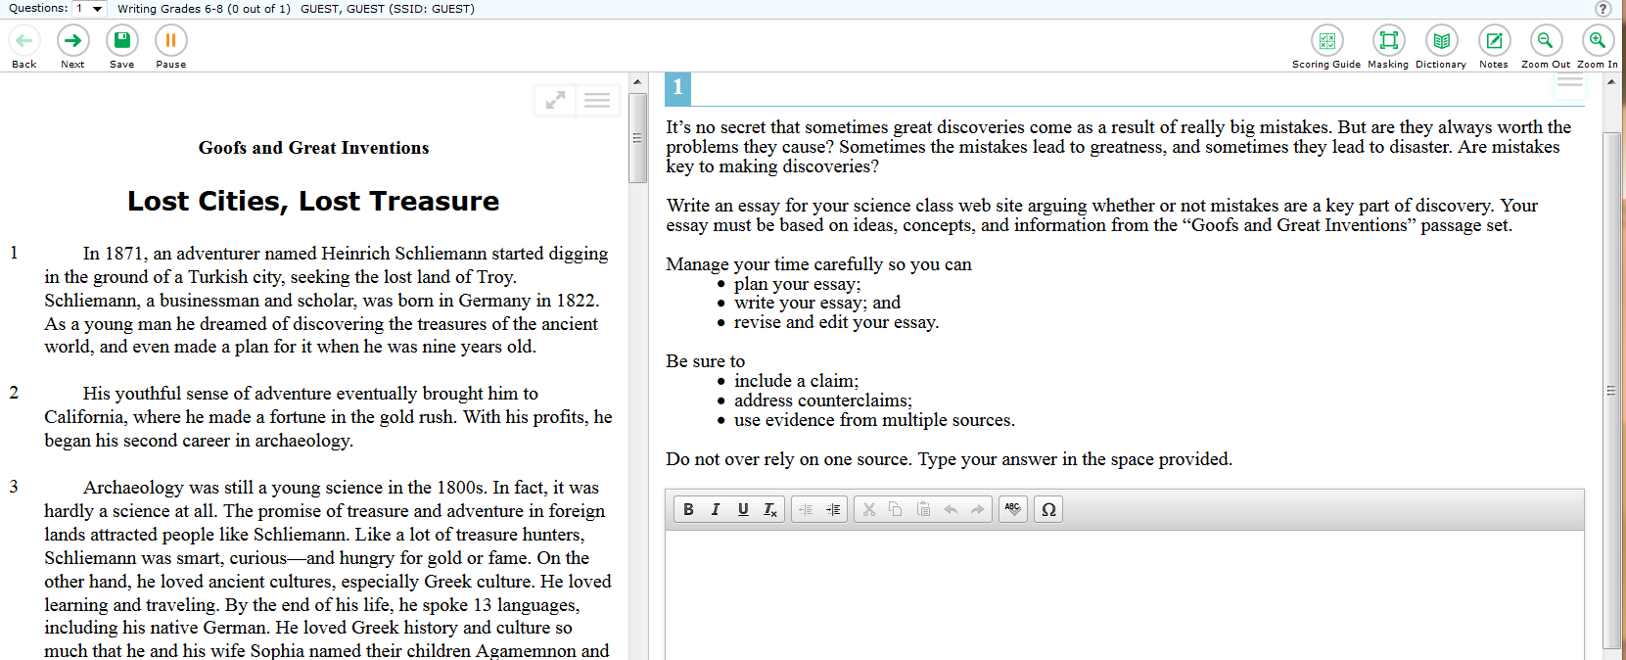
Navigation, Writing, and Test Tools
Navigation Tools
Test Tools
The Navigation Tools enable students to move to the next or previous test question, save answers during a test, and/or pause their test.
Test Tools help students to answer questions specific to the given test. These will be reviewed on the next few slides.
Within the Writing Test, the Writing Tools enable students to bold text, italicize text, underline text, remove text formatting, increase or decrease text indentation, cut, copy, or paste text, “undo” and “redo” recent writing actions, check spelling, and insert text symbols.
Writing Tools

Slide 36
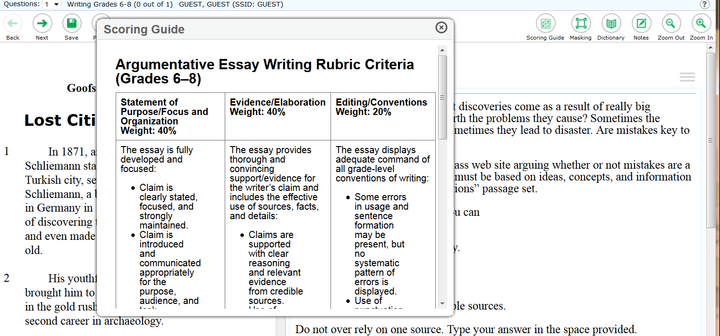
Scoring Guide
Within the Writing test, the Scoring Guide allows students to see the proportional scoring weights for the different aspects of their written essays.

Slide 37
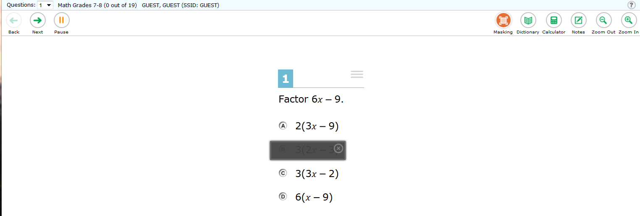
Masking
Masking allows students to “mask” over options or items they want to temporarily remove from consideration.

Slide 38
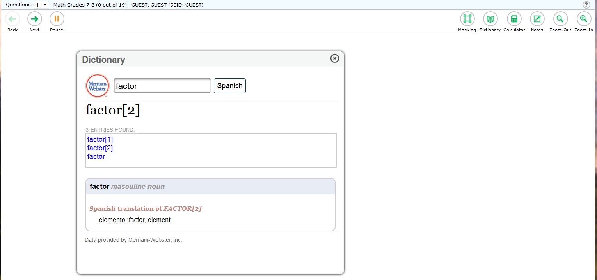
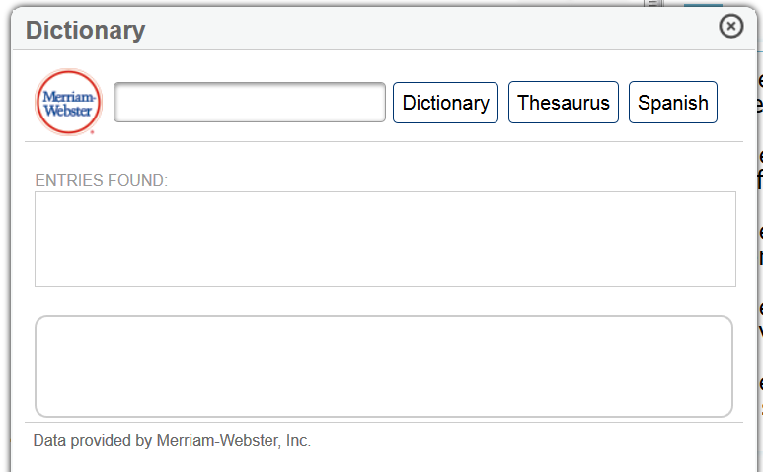
Dictionary
Math and Science Dictionary
The Dictionary allows students to:
1) type in words they wish to have defined, and/or
2) Click on this box to see the Spanish translation of a word displayed here.
ELA Dictionary
The ELA: Writing, Reading, Language, and Listening Dictionary also provides a “Thesaurus” button.

Slide 39
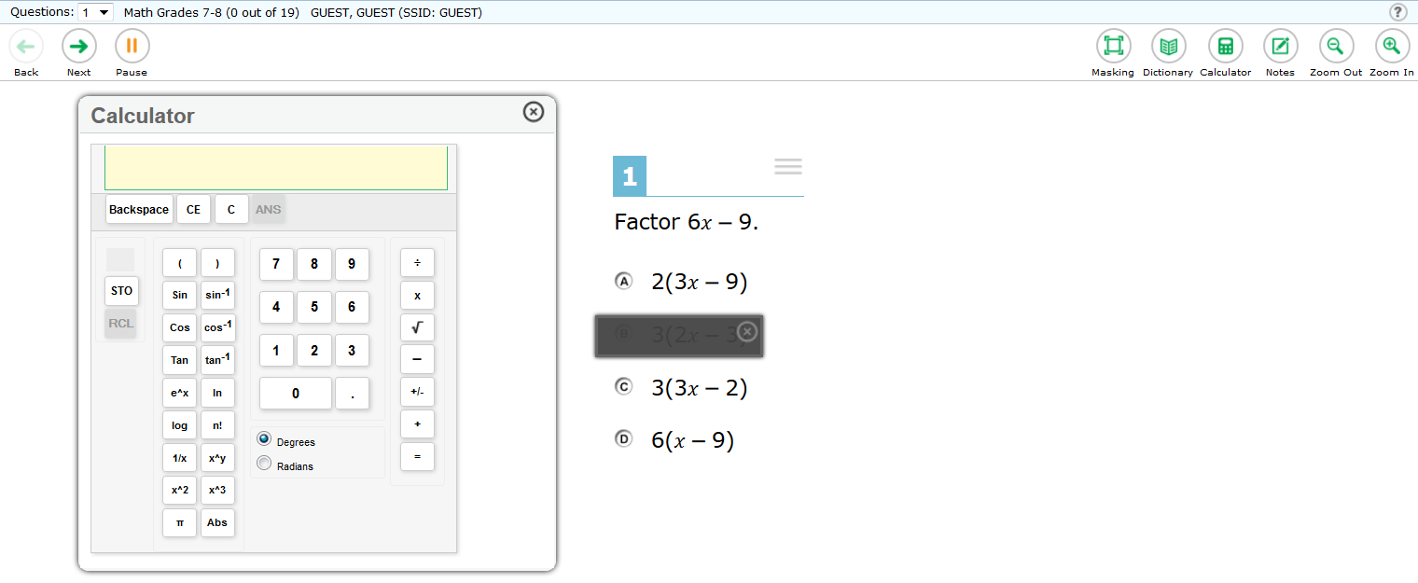
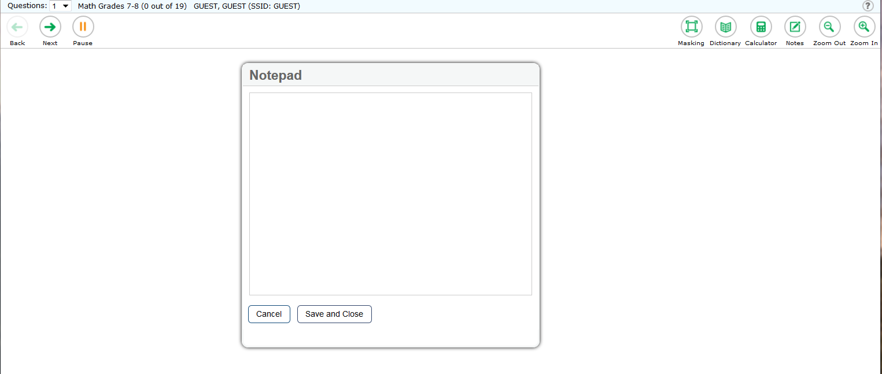
Calculator and Note Tools
Clicking the “Calculator” button will provide an online calculator for students to use.
Clicking the “Notes” button will produce a notepad that students can use during the current testing session.
Any notes created during a testing session are NOT saved when the testing session is closed.

Slide 40
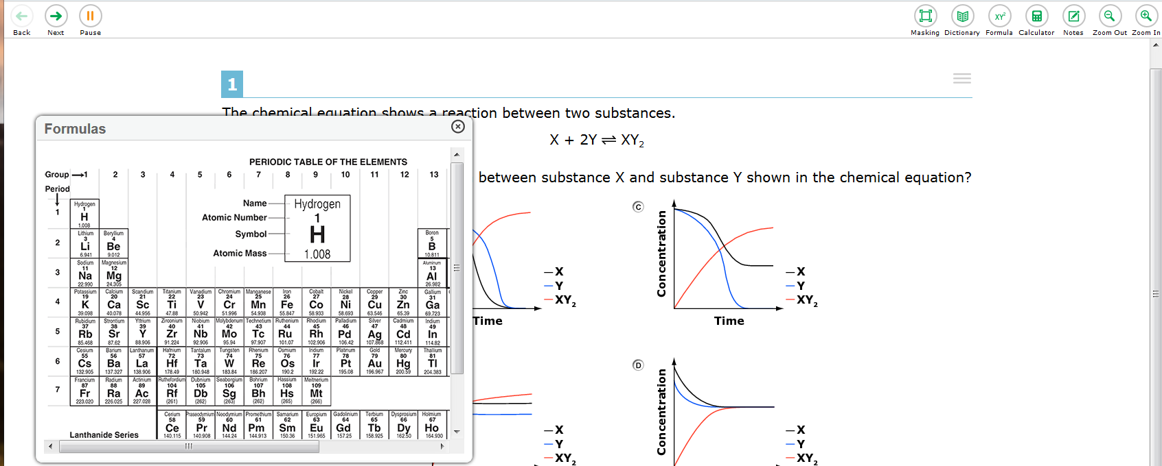
Formulas
Some SAGE assessments provide a “Formula” button to access formulas and/or charts to assist in solving test questions.

Slide 41
Additional Test Tools
Test Tools also include “Zoom Out” and “Zoom In” buttons to enlarge or decrease the font size during testing.
In the upper right corner of each SAGE test, there is a “?” button to provide help in using all Testing Tools.
Also in the upper right corner of each SAGE test, there is this button which allows students to adjust the volume of sound during the Listening portion of the ELA test or when using Text-to-Speech.

Slide 42
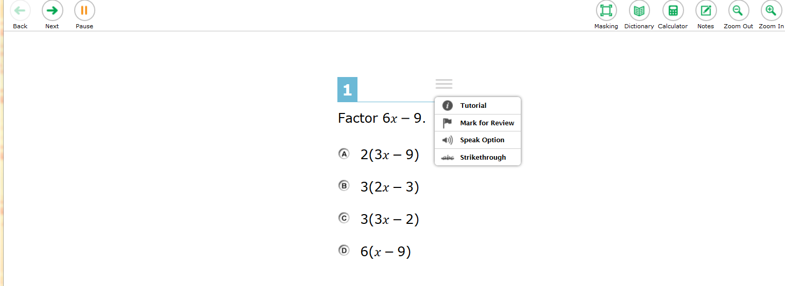
Context Menus
Each SAGE test question has one or more sets of three horizontal bars. When clicked, these horizontal bars provide a “Context Menu” of available actions for that question. An example of a “Context Menu” is provided below:
The “Tutorial” provides a video clip to help the student know how to respond to the given question.
To determine available text-to-speech options available for the question, select the “Speak Option”.
If the student wants to “flag” the question and revisit it later, the “Mark for Review “ option would be selected.
To enable a “Strike through” tool, students would select this option.

Slide 43
Text-to-Speech
Students can listen to test instructions, passages, and questions as appropriate. For the ELA Reading/Listening items, some passages will not be read aloud.
Students should be provided with opportunities to practice the use of “Text-to-Speech”. Have students log in to a training test, using the secure browser. This will enable the “Text-to-Speech” features so students can practice:
To listen to a passage, click the passage context menu and select the [Speak] option you want. You can select a small portion of text, such as a word, phrase, or paragraph to listen to. Select the text, click the passage context menu, and select the [Speak Selection] option.
To listen to a question or answer options, click the question context menu and select the [Speak] option you want.
To listen only to the question, select [Speak Question] .
To listen to the multiple-choice question and all answer options, select [Speak Question and Options] .
To listen only to the answer option, click on the answer option select [Speak Option]. You can also right-click on the answer option and select [Speak Option]. (For example, if you want to listen to answer option A, right-click on that answer option and select [Speak Option A].)

Slide 44
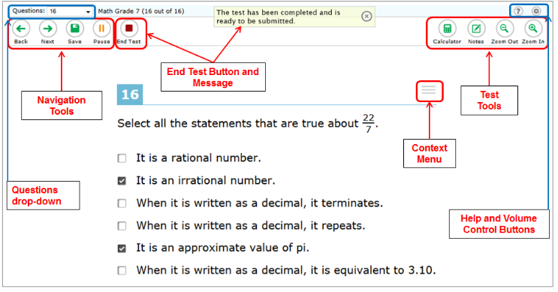
Proceeding Through the Test
To answer multiple-choice items, students must click the desired option or click the circle with A,B, C, or D.
To answer machine-scored constructed response items, students need to carefully follow the instructions given for each question.
Each question MUST be answered before going on to the next question.
If a student is unsure about a given question, he/she may “flag” it for review later using the “Context Menu”.

Slide 45
Item Sets
Some questions are grouped together because they are based on the same reading passage, simulation, or listening passage.
Students can move through these questions using the number button (highlighted in the red box above) or the “Next” or “Back” button.
All questions in the “Item Set” must be answered before a student can move to later questions in the test.

Slide 46
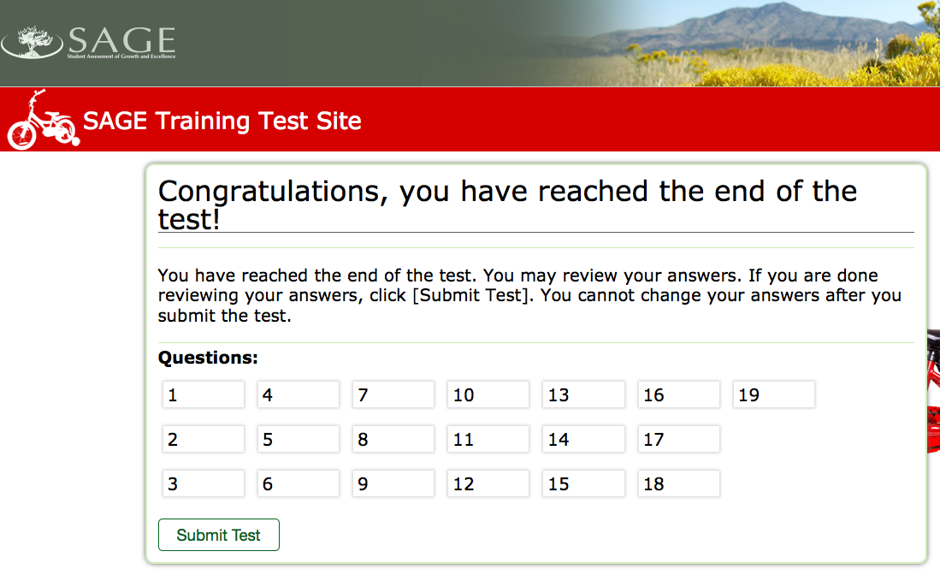
Ending a SAGE Test
When a test is completed, the “End Test” button will appear.
Clicking on the “End Test” button will produce this message. To continue ending the test click “Yes”.
This message will next appear.
To review questions before submitting a test, students can select the questions.
To submit the test, click on “Submit Test”.

Slide 47
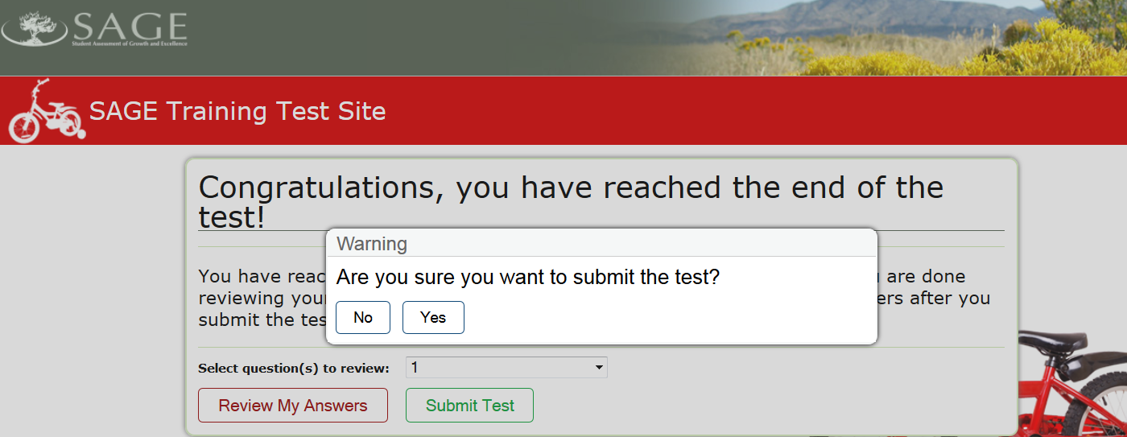
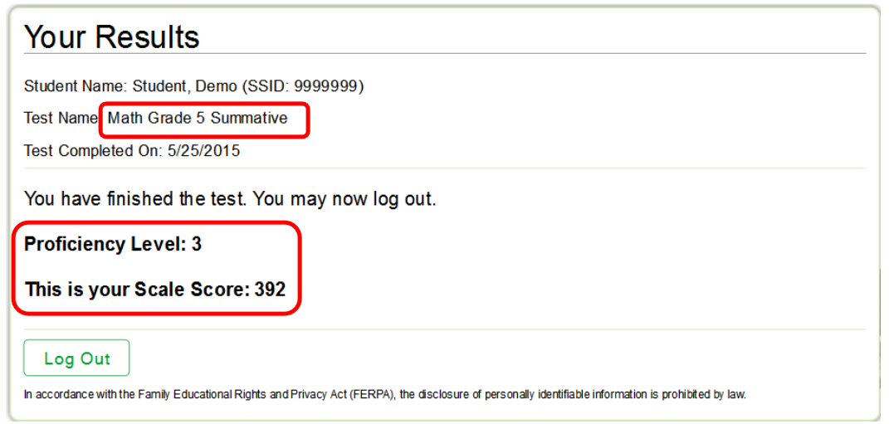
If the student is sure he/she wants to submit his/her test, the “Yes” button is clicked here.
For Math and Science SAGE tests, the student’s scale score and proficiency level will be immediately displayed.
For ELA and Writing SAGE tests, results will be available in ORS once both ELA sections are completed.
To “Log Out” of the test, students click here.

Slide 48
Online Reporting System (ORS)
Score Reports

Slide 49
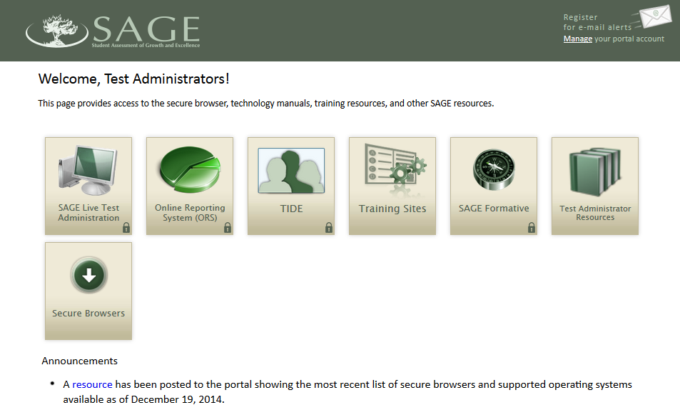
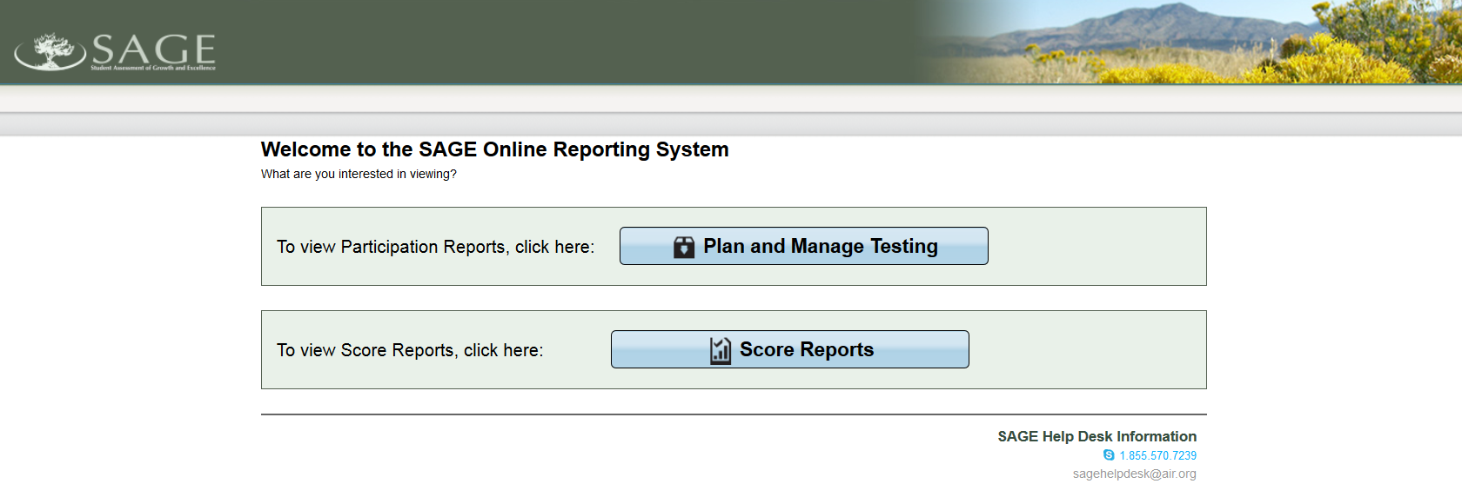
Accessing Score Reports within ORS
To Access “Score Reports” within ORS:
Select the ORS card after logging in to SAGE.
Select the “Score Reports” bar.

Slide 50
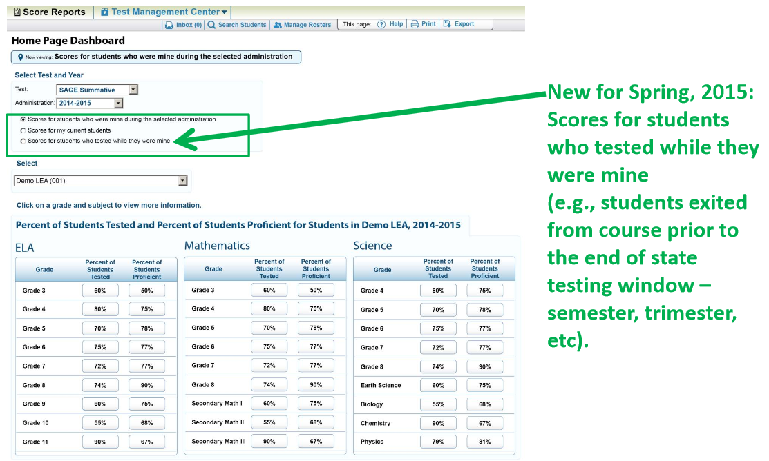
Score Reports Home Page Dashboard
A reminder of which students are included in the reports is provided here.
To access students’ 2015 SAGE performance:
Select “Summative 2014-2015” as the reported Administration.
Select which students to include in the reports.
Select the test results to be reviewed by clicking on the “Percent of Students Proficient” OR the “Percent of Students Tested” for the selected test.

Slide 51
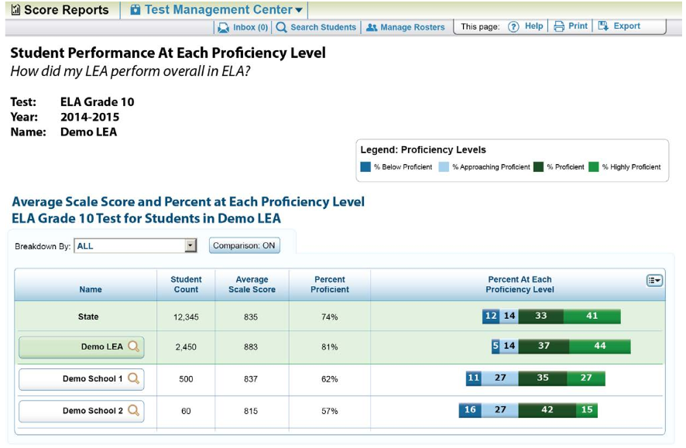
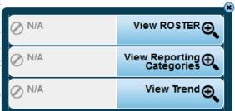
State, District, and School Level Performance for the 2014-15 SAGE Test
Test, Test Year, and District/School Information
Options:
ALL
Ethnicity
LEP
Special Ed.
Clicking the will bring up the Exploration Menu.

Slide 52
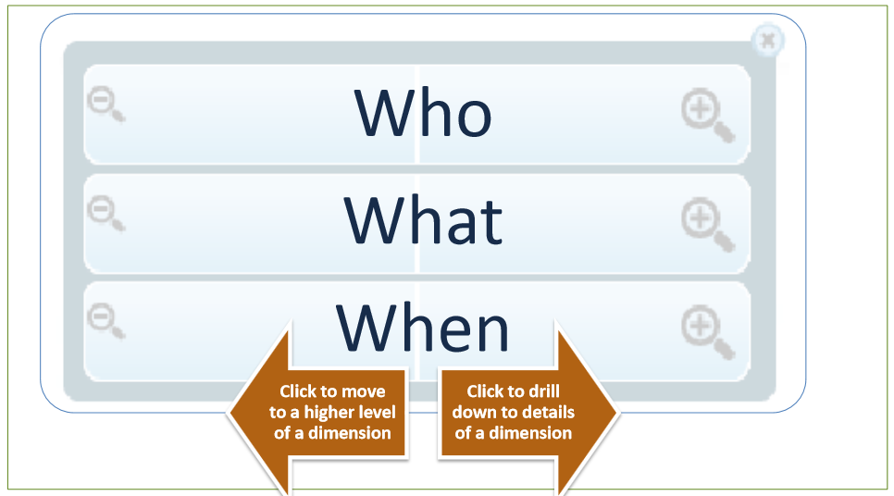
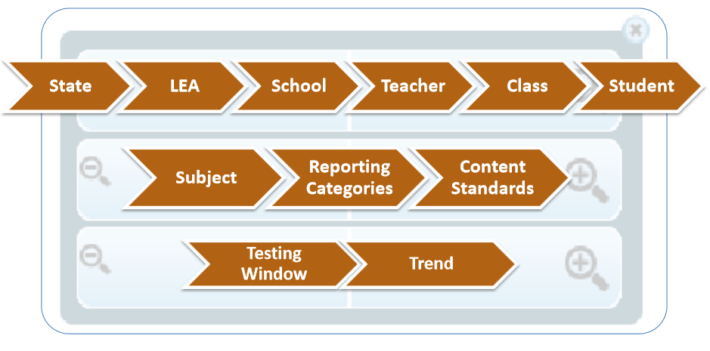
Exploration Menu

Slide 53
Navigating the “Who” Dimension
The user can move from aggregated information levels to disaggregated information levels, down to the student level.

Slide 54
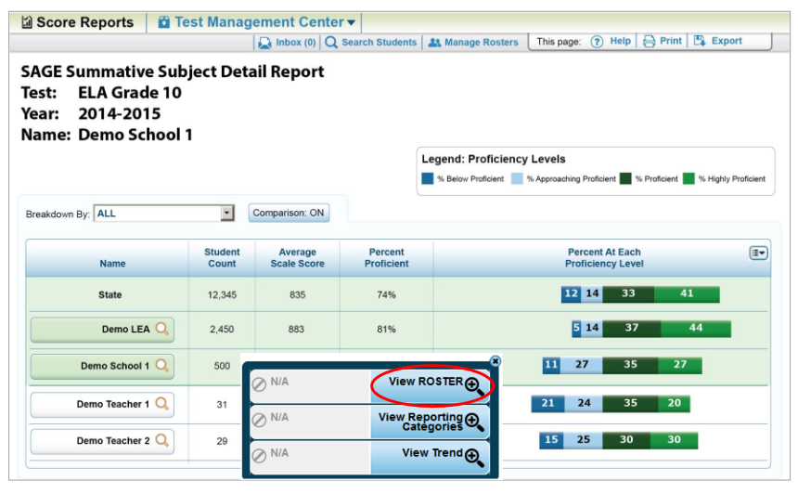

Slide 55
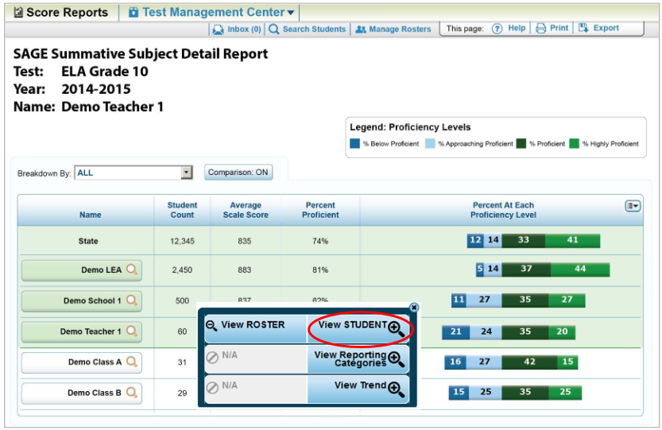

Slide 56
For 2015, note the addition of sub-test scale scores.

Slide 57
Individual Student SAGE Report
For 2015, there will be two data points to determine growth from the 2014 Summative SAGE test to the 2015 Summative SAGE test.

Slide 58
Navigating the “What” Dimension
The user can navigate down from the subject level to view finer-grain detail on reporting category and content standard performance.

Slide 62
Navigating the “When” Dimension

Slide 63
References
Test Administration Manual (TAM) can be found by clicking on this link:
http://sageportal.org/wp-content/uploads/2015-2016-SAGE-Interim-TAM.pdf
This presentation and the TAM will be posted to dcsdtraining.weebly.com under the “more” tab, SAGE training.
SAGE testing and training resources are available at USOE through the following website: http://www.schools.utah.gov/assessment/Testing-Director-Resources.aspx
Additional SAGE testing and training resources are also available on the sageportal: http://sageportal.org/resources/
My email is tfelkins@dcsd.org and my phone # is 725-4602.

