Slide 1

Helping teachers connect instantly
with students and parents

Slide 2
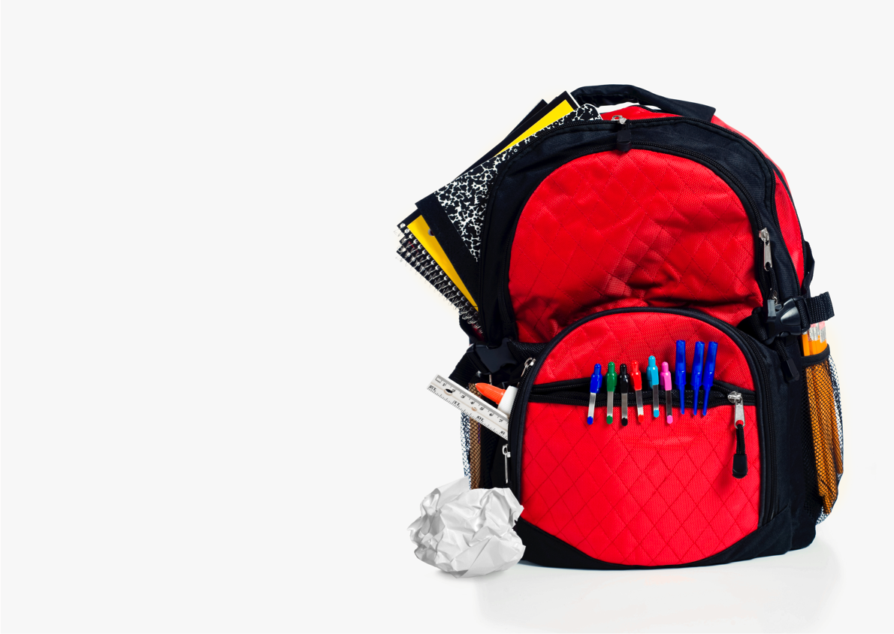
Is this your communication strategy?

Slide 3
Meet students where they are
OF WORLD’S POPULATION OWN
a mobile phone
OF AMERICAN STUDENTS USE
text messages
OF AMERICAN YOUTH SAY
texting is a favorite activity
Notes:
image: https://drive.google.com/a/remind101.com/folderview?id=0B7iGvhMaqEhUbDkxRk81akRyd3c&usp=sharing

Slide 4
Texting parents impacts education
Stanford Research, Teacher-Family Communication
INCREASED
parent engagement at home
INCREASED
parent engagement at school
INCREASED
student literacy
SOURCE One Step at a Time: The Effects of an Early Literacy Text Messaging Program for Parents of Preschoolers
Notes:
cite harvard study (mobile communication)

Slide 5
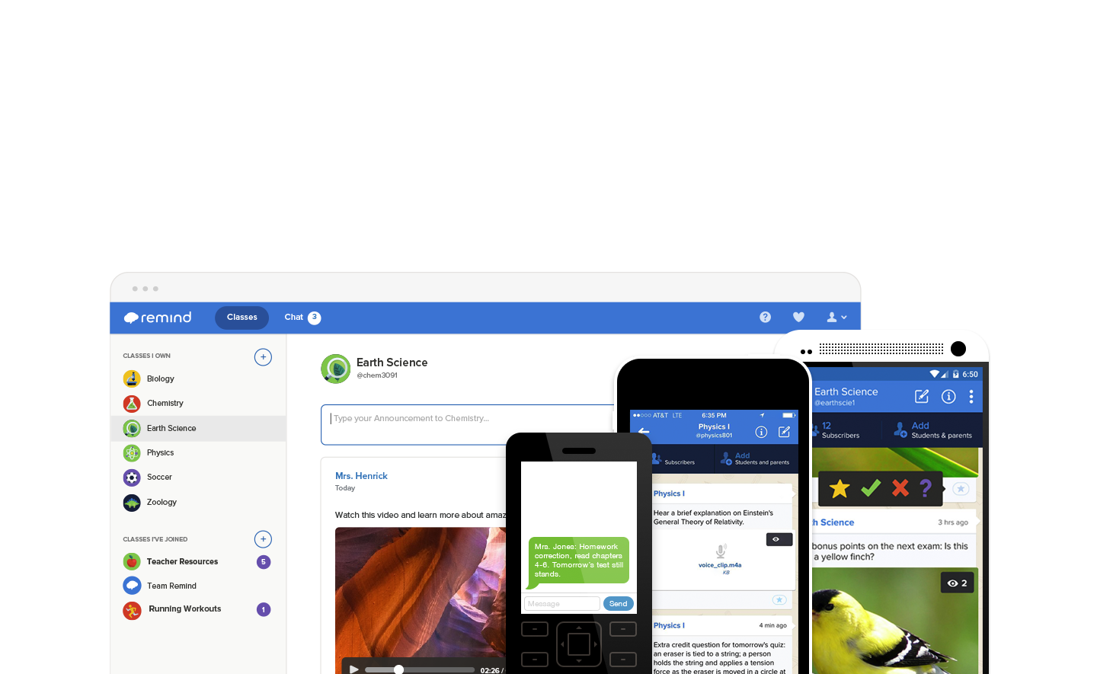
Why Remind vs. text messaging?
SAFE
Teachers never see students’ phone numbers, and students never see theirs.
SIMPLE
Sign up in 15 seconds on
any device.
ACCESSIBLE
Engage when and how
you prefer.

Slide 6
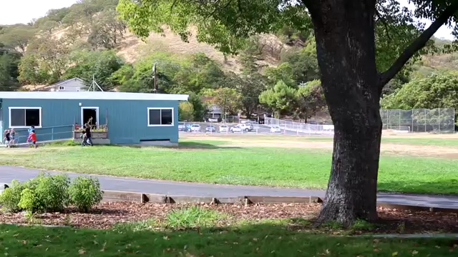
Remind Builds Community
SOURCE Watch Online

Slide 7
What is Remind?

Slide 8
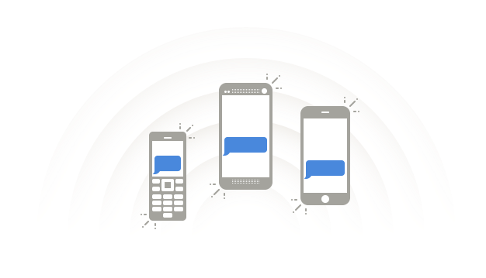
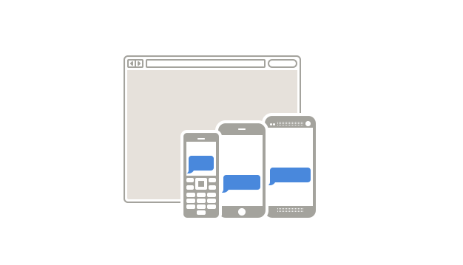

Key Features
CONNECT INSTANTLY
Sign up in 15 seconds on the web
or mobile app.
Students and parents can join your class by text, email or app.
CONNECT FREELY
Teachers, students, and parents
can use for free.
No commitments or classroom changes required.
CONNECT SAFELY
Phone numbers are always
kept private.
Download or e-mail your
message history.
Flag or report conversations.
CONNECT EFFICIENTLY
Send or schedule messages
ahead of time.
Attach photos, files, or voice clips.
Reach out 1:1 with Chat.
Get instant feedbacks with Stamps.

Slide 9
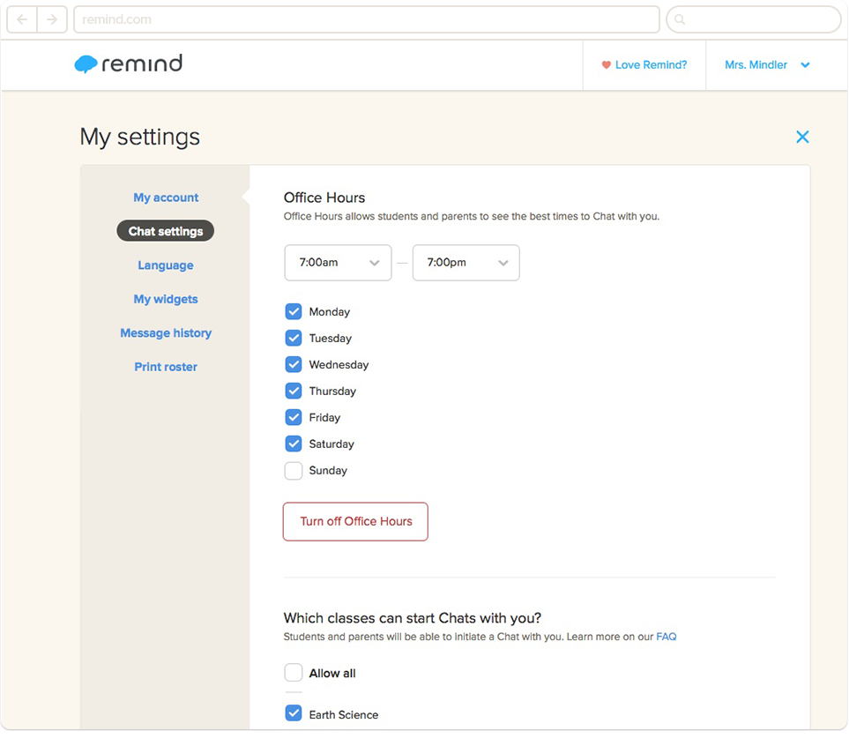
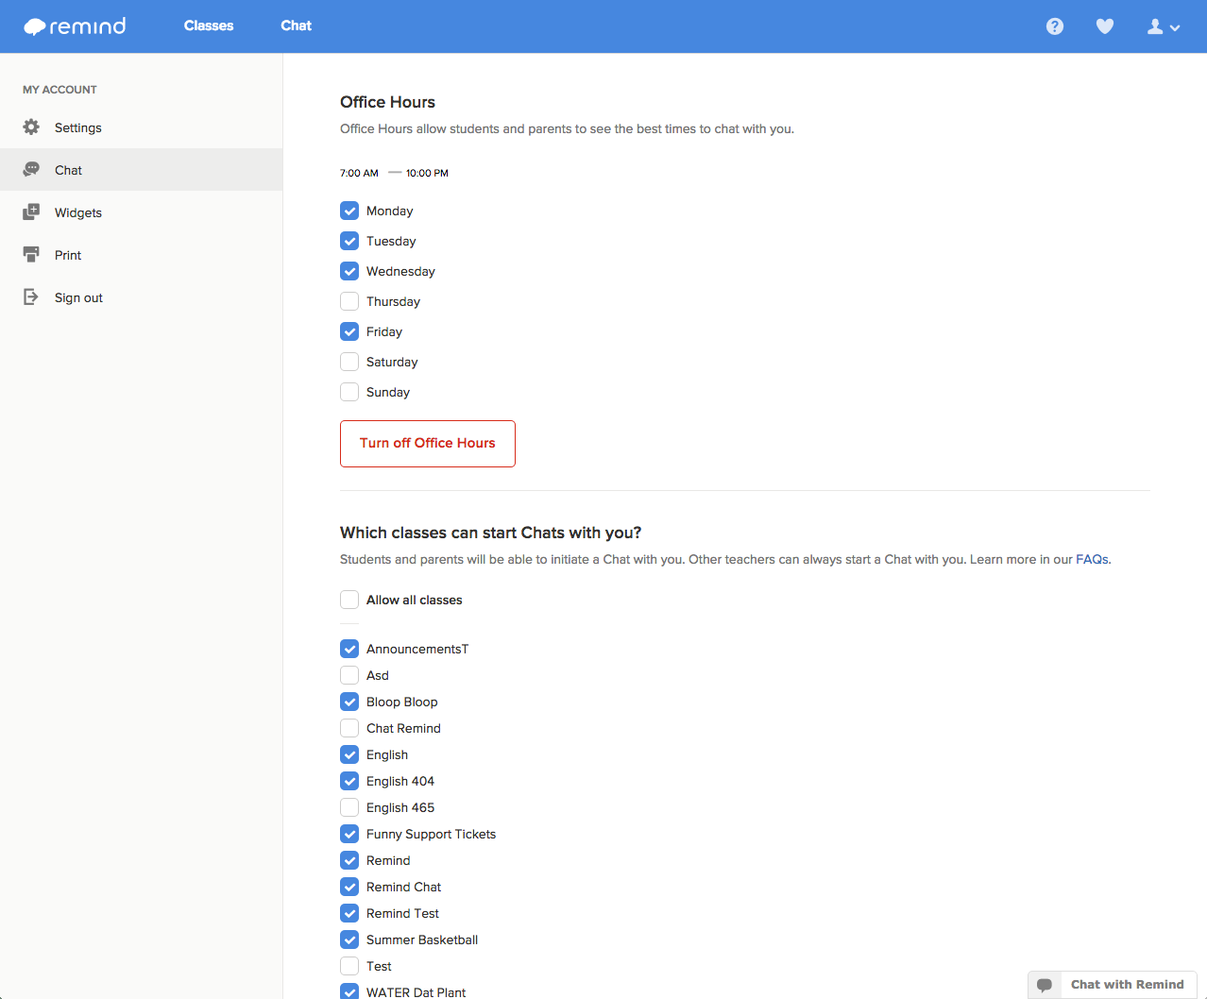
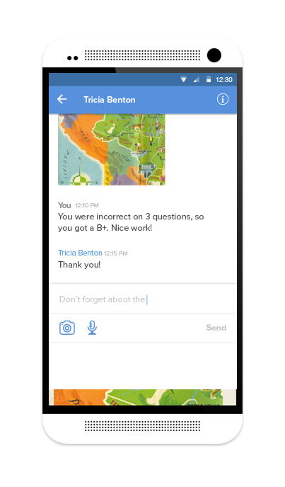
Choose how to connect with Chat
Reach out to subscribers 1-1 when
you need to
    Allow subscribers to initiate, or leave outreach in your control
    Set Office Hours for work-life balance
    Access a transcript or e-mail
    a conversation any time
    Chat is opt-in. Teachers can also
    use Remind to send one-way Announcements only.

Slide 10
Teachers everywhere are telling us
that Remind is making an impact
Remind is for everyone
90% of users are public school teachers
Remind engages students
More than 50% of K-12 teachers said that Remind homework turn-in rates increased
Remind involves parents
Over 60% of K-12 teachers
said that Remind increased
parent involvement
Notes:
Potentially add a powerful quote from a teacher

Slide 11
Get started with Remind in 15 seconds!

Slide 12
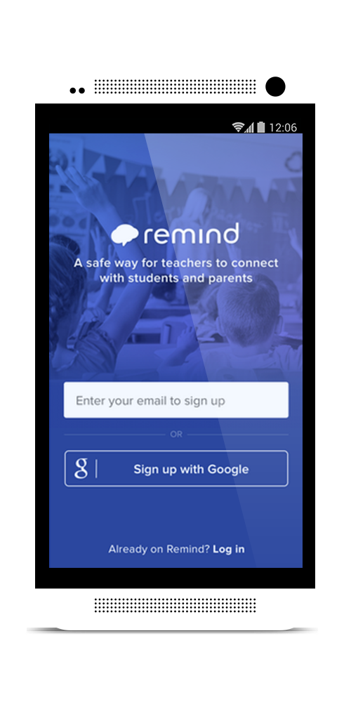

Step 01
Download App
or Visit Site
Sign up via Remind.com OR
Download our mobile app on iOS or Android

Slide 13
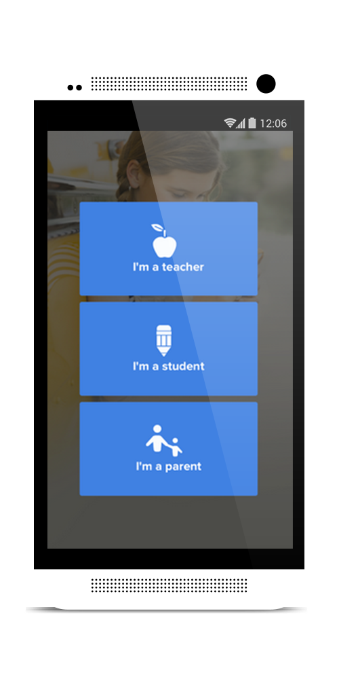
Step 02
Register
Select your role
Enter your full name
and e-mail address
Create password
Notes:
presenter tip: TIP: Don’t worry about the Title - that’s just how Remind contacts you in emails - you can always update your “Recognized Name”, which is what students & parents see before each message.)

Slide 14
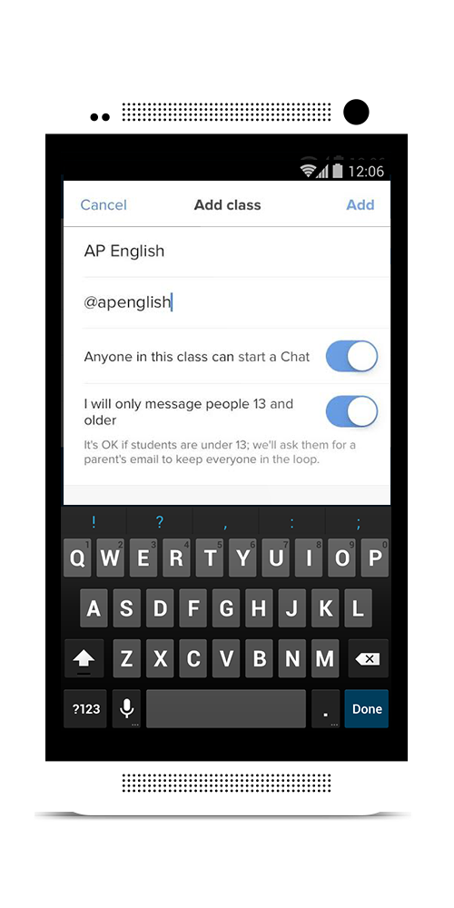
Step 03
Once you’re registered,
add a Class
Name your class
Mark whether there are students
under the age of 13
Things to know:
Create up to 20 class groups
Name your class something recognizable
Organize your classes by subject level or audience group (students, parents, or both)
Notes:
presenter tip: TIP: Don’t worry about the Title - that’s just how Remind contacts you in emails - you can always update your “Recognized Name”, which is what students & parents see before each message.)

Slide 15
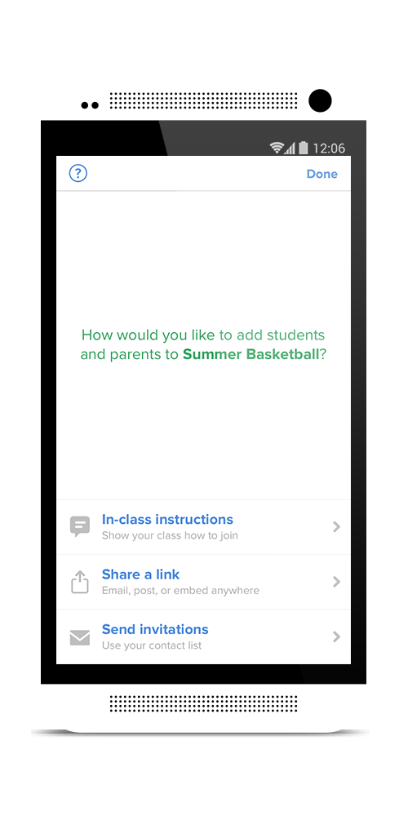
Step 04
Invite students and parents to join the class
Students and parents can join your class by
your unique class @code. Send the code in
these three ways:
Project or send instructions to download
the app or text class @code to your Remind
phone number
Share your unique link: remind.com/join/code
to have your class join by mobile number
Invite students and parents by e-mail or
mobile number
Things to know:
Invite students and parents in these ways
BACK TO SCHOOL NIGHT
FIRST DAY OF SCHOOL
SEND AN E-MAIL
PRINT PDF AND SEND HOME
POST ON CLASS WEBSITE
SOCIAL MEDIA

Slide 16
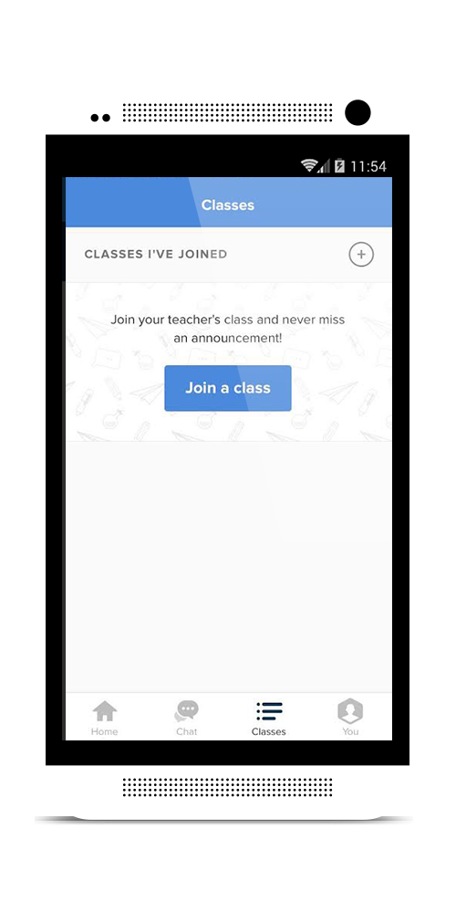
Join my class to see how it works!
Download the Remind app if you haven’t already on iOS, Android, or Chromebook. Simply search for Remind in the app store or go to rmd.me
Navigate to “Classes” located at the bottom, then “Joined” at the top.
Join my class @_________.

Slide 17
Ways to get started with Remind
LESSON PLANNING
Remind’s schedule ahead option allows you to plan an entire unit, or even school year, at a time!
HOMEWORK ASSIGNMENTS
Easily send your students and their parents the homework assignment each night through a quick Remind message.
CLASS DOCUMENTS
Attach important class files and photos to your messages. View who has opened your attachments and get instant feedback with Stamps.
QUESTIONS FOR CRITICAL THINKING
Extend learning beyond the classroom by sending your students preview questions for the next lesson. Student can quickly respond with Stamps.
MOTIVATIONAL MESSAGES AND IMAGES
Encourage students to reach their goals through motivational messages and attached inspirational images. Students can star your messages
with Stamps.
FACTS AND TIPS
Send students daily facts or vocabulary words straight to their cell phones each day.
TRIVIA
Send students trivia questions based on content they’ve learned in class. Get instant student feedback with Stamps.
LAST-MINUTE SCHEDULE CHANGES
Alert your students and their parents of last-minute schedule changes in the school or class calendar.

Slide 18
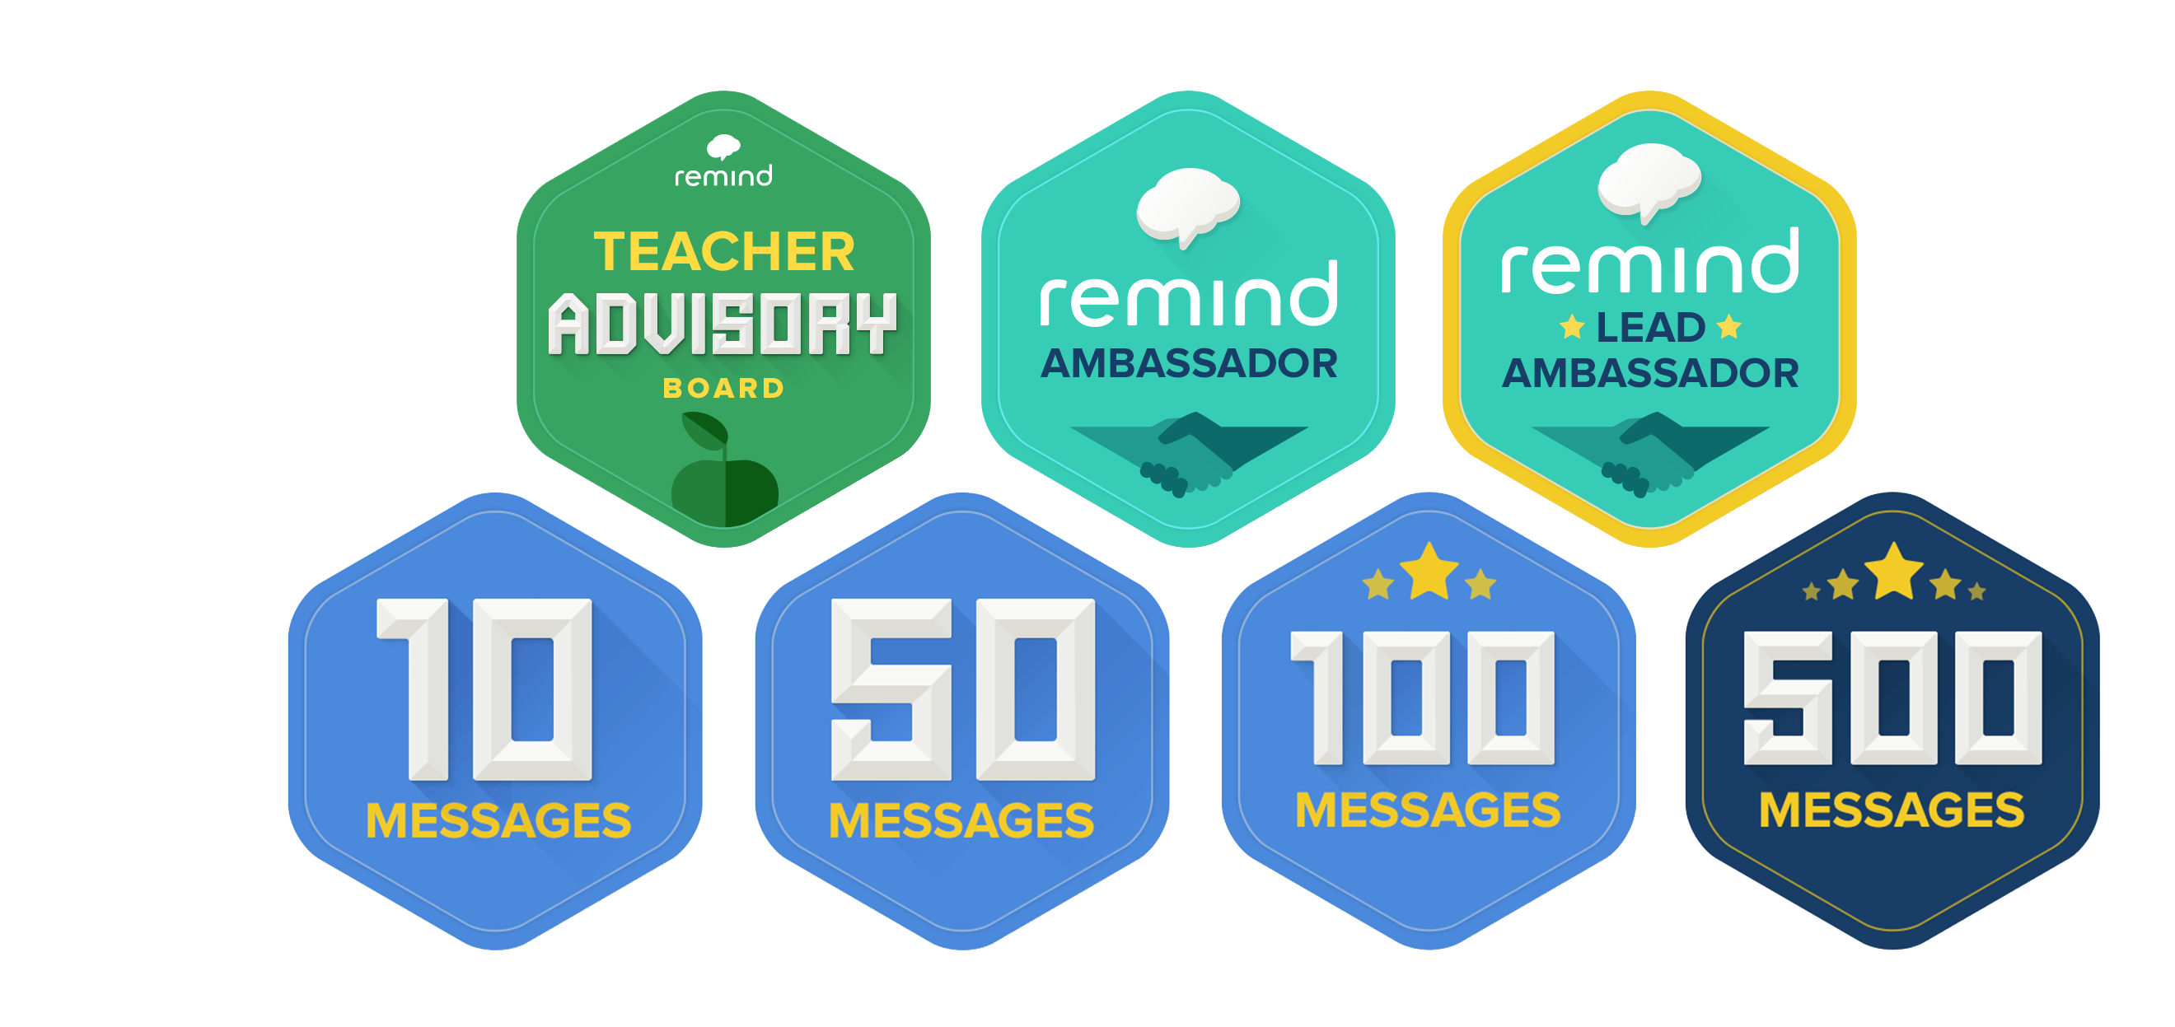
Help Remind reach our vision:
Connect every teacher, parent, and student in the world to improve education
Want to be a Remind ambassador?
remind.com/ambassadors/

Slide 19
Remind works school-wide
Educators and school community members who use Remind
CLASSROOM TEACHERS
RESOURCE TEACHERS
COACHES
TUTORS
ADMINISTRATORS
CLUB LEADERS
LIBRARIANS
ROOM PARENTS
TECHNOLOGY COACHES
EDUCATION PROFESSORS
OFFICE MANAGERS
AND MANY MORE!

Slide 20
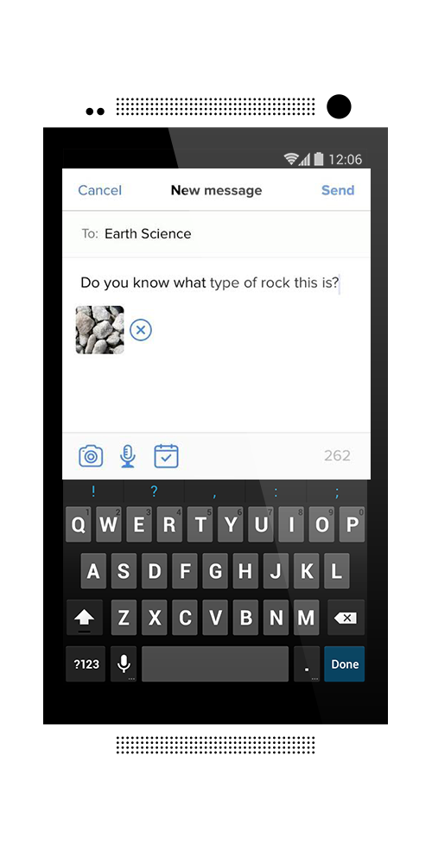
Question:
How could you benefit
from using Remind?

Slide 21




Remind is built on teacher feedback.
Join our community of teachers.
Share tips, feedback and feature requests by joining us on:
RemindHQ
@RemindHQ
RemindHQ
@RemindHQ
Got a question about your account? Get in touch with us:
contact@remind.com

